Slide 1
PLASMA
It is called “the fourth state of matter” comes from the Greek word plásma and means “moldable substance” or “jelly”.
Plasma was first identified by Sir William Crookes in a Crookes tube in 1879.
He gave name as “radiant matter”
Irving Langmuir in 1927, studied the ionized gas and gave this new state of matter the name “Plasma”.
More than 99% of the mass of the universe is in the Plasma state.
It is a hot ionized gas consists approximately equal numbers of positive ions and free.
Electrons resulting in more or less no overall charge.

Slide 2
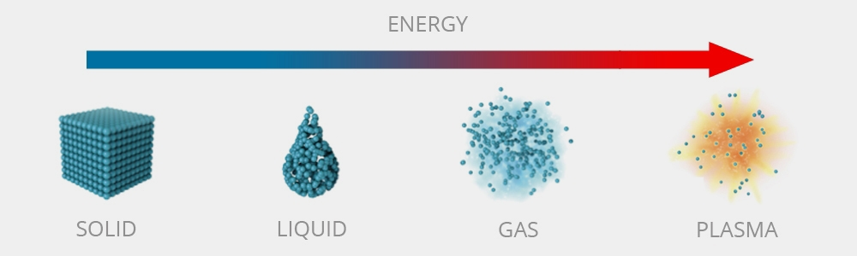
As the fourth state of matter
As far as we know, matter generally exists in three states in nature.
These are: (𝑖) 𝑆𝑜𝑙𝑖𝑑 (𝑖𝑖) 𝐿𝑖𝑞𝑢𝑖𝑑 and (𝑖𝑖𝑖) 𝐺𝑎𝑠.
Now when a solid is heated sufficiently that the thermal motion of the atoms break the crystal lattice structure apart, usually a liquid is formed.
When a liquid is heated enough that atoms vaporize off the surface faster than they recondense, a gas is formed.
Now what happens to a matter just after that gaseous state?
When a gas is heated enough ( 𝑇 > 100,000℃ ) that the atoms collide with each other and knock their electrons off and in this process a mixture of ions, electrons and neutral atoms is formed.
This is called Plasma: The so-called “fourth state of matter”.
http://www.plasmasurgical.com

Slide 3
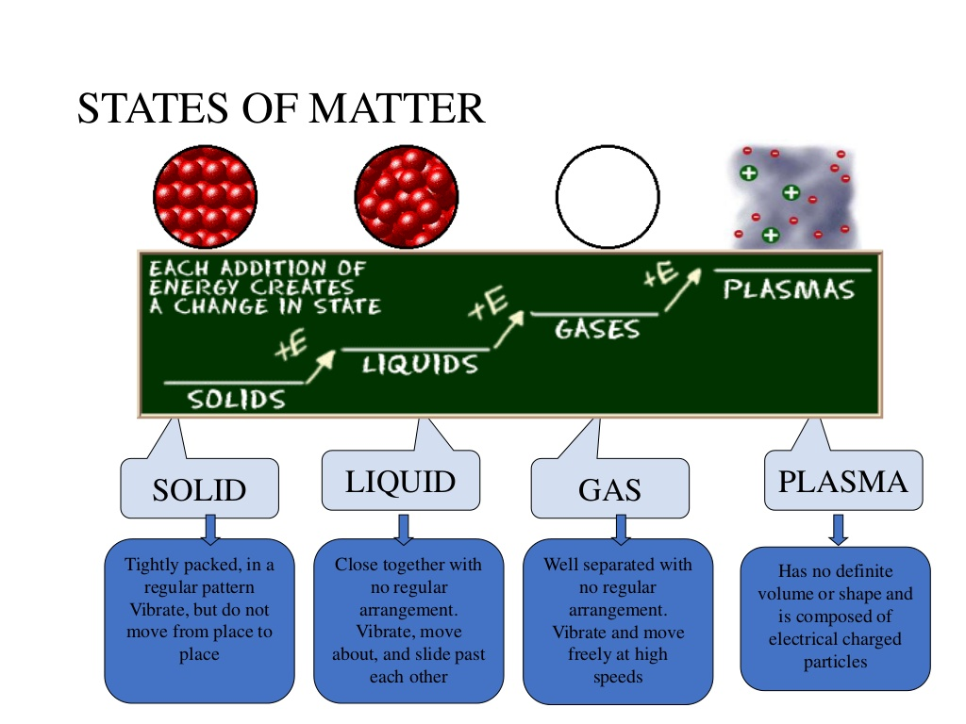
https://apsplasma.com/

Slide 4
Characterization of Plasma
Plasma is characterized by following parameter
Electron temperature
Charge particle number density
Details on attached page

Slide 5
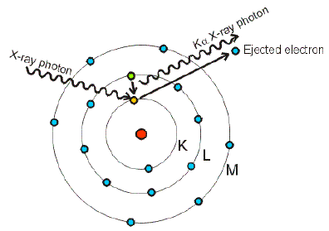
HOW TO CREATE PLASMA??
There are many different methods of creating plasmas in the laboratory. The most commonly known processes are (𝑖) Photoionization and (𝑖𝑖) Electric discharge in gases.
(𝑖) Photoionization : In that process, ionization occurs by absorption of incident photons whose energy is equal to or greater than the ionization potential of the absorbing atom.
The excess energy of the photon is transformed into kinetic energy of the electron-ion pair formed. Ionization can also be produced by X-rays or gamma rays, which have much smaller wavelengths.
https://projects.exeter.ac.uk

Slide 6
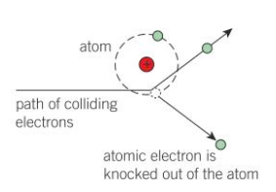
(𝑖𝑖) Electric discharge: In a gas discharge, an electric field is applied across the ionized gas, which accelerates the free electrons to energies sufficiently high to ionize other atoms by collisions.
When a high-speed electron collides with an electron bound to a nucleus, it can give both electrons enough energy to escape. Thus, ionization is occurred.
https://quizlet.com

Slide 7
Waves in Plasmas
Waves in plasmas are an interconnected set of particles and fields which propagate in a periodically repeating fashion.
Due to its electrical conductivity, a plasma couples to electric and magnetic fields. This complex of particles and fields supports a wide variety of wave phenomena.
The electromagnetic fields in a plasma are assumed to have two parts, one static/equilibrium part and one oscillating/perturbation part.
Depending on the oscillation of magnetic field, plasma waves can be classified into electromagnetic or electrostatic.
When Faraday’s law of Electromagnetic Induction is applied then it is found that electrostatic waves are purely longitudinal whereas electromagnetic waves may be longitudinal and transverse both.

Slide 8
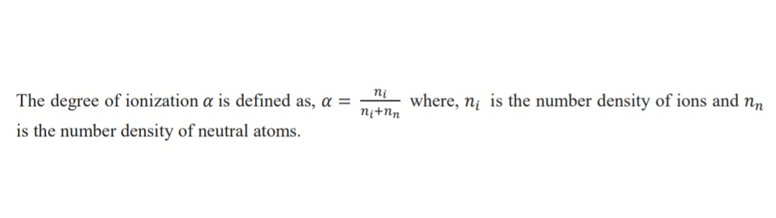
CLASSIFICATION OF PLASMAS
The degree of ionization of a plasma is the proportion of charged particles to the total number of particles including neutrals and ions.
Depending on the degree of ionization of the plasma it is classified as (𝑖) Fully ionized plasma, and (𝑖𝑖𝑖) Partially ionized plasma
(𝑖) Fully ionized plasma: A fully ionized plasma has a degree of ionization approaching 1 (i.e., 100%).
Examples: The Solar Wind (interplanetary medium), stellar interiors (the Sun’s core), fusion plasmas.
(𝑖𝑖𝑖) Partially ionized plasma : A partially ionized plasma has a degree of ionization that is less than 1.
Examples: The ionosphere, gas discharge tubes.

Slide 9
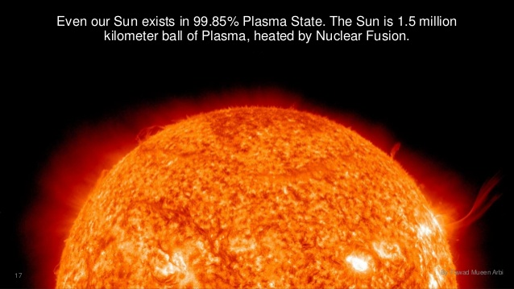
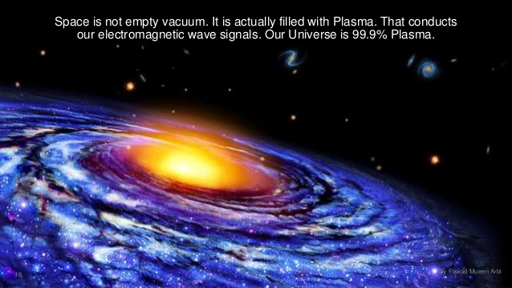
PLASMAS IN NATURE
Plasma in Space
Stars
Coronas
Solar wind
Star nurseries
Interstellar Nebulae
The accretion disks and accretion disk
jets of black holes
Sun exists in 99.85% plasma state.
The Sun is 1.5 million Km ball of
plasma heated by Nuclear Fusion
Space is not empty vacuum. It is
actually filled with plasma that
conducts our EM wave signals.
Our Universe is 99.9% Plasma
https://www.plasmas.org/

Slide 10



Terrestrial Plasmas
Fire (When hotter than 1500℃)
Lightning
The magnetosphere
The ionosphere
The plasmasphere
The polar aurorae
The polar wind
Upper atmospheric lightning (e.g. Blue jets, Blue starters)
Sprites
https://www.plasmas.org/

Slide 11


Artificial Plasma
Those found in plasma displays, including
TV screen
Inside fluorescent lamps, neon signs
Rocket exhaust and ion thrusters
The area in front of a spacecraft’s heat shield
during re-entry into the atmosphere
Fusion energy research
The electric area in an arc lamp, an arc welder or
plasma torch
Plasma ball (Plasma sphere or Plasma globe)
Arcs produced by Tesla coils
Plasmas are used in semiconductor device
fabrication
Laser produced plasma
Static electric sparks
In Fusion Test Reactor (FTR) to produce
controlled thermonuclear fusion power
https://www.plasmas.org/

Slide 12
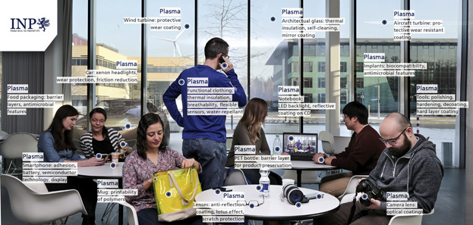

Slide 13
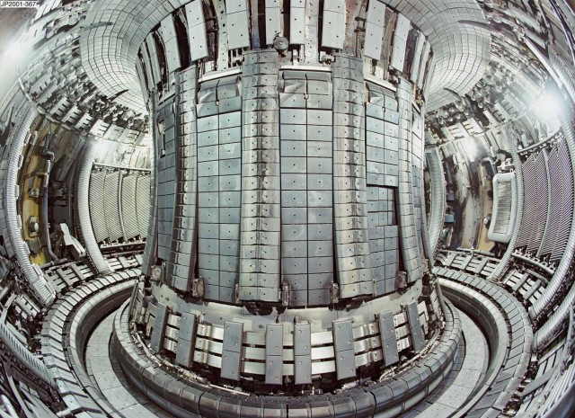
HOW TO CONTAIN IT
Because of the extreme heat of most plasmas, conventional materials can not be used to contain plasma.
However, Plasma is an excellent conductor and hence magnetic fields are used to contain high-density, high-temperature plasmas because such fields exert pressures and tensile forces on the plasma.
Tokamak Reactor
https://phys.org

Slide 14
FUTURE OF PLASMA
One of the great challenges of humankind is to create high temperatures in a controlled manner and to harness the energy of nuclear fusion.
This is the great practical goal of Plasma Physics to produce nuclear fusion on the Earth. Modern Plasma theory has developed to meet the demands of fusion research.
Researchers have used the properties of plasma as a charged gas to confine it with magnetic fields and to heat it to temperatures hotter than the core of the sun. Thus scientists have used Plasma in Fusion Test Reactor (FTR).
Other researchers pursue plasmas for making computer chips, rocket propulsion, cleaning the environment, destroying biological hazards, healing wounds and other exciting applications.

Slide 15
References
J. A. Bittencourt , ‘ Fundamentals of Plasma Physics ’ , Springer Press.
Robert J. Goldston and Paul H. Rutherford , ‘ Introduction to Plasma Physics ’ , Institute of Physics Publishing Bristol and Philadelphia.
P. K. Karmakar , ‘ Plasma: A unique state of matter ’.
https://www.plasmatreat.com/
http://www.psfc.mit.edu/
https://phys.org
https://www.plasmas.org/
https://www.wikipedia.org/

